Slide 1
ForkJoinPools
&
parallel streams
… are useless?

Slide 2
Agenda
Motivation
History
Big Picture
ForkJoinPool
Parallel streams
Advises
Alternatives

Slide 3
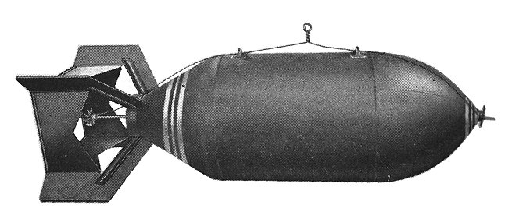
:(){ :|:& };:
Notes:
Try it out, but not in your production server.
Better to do it in your laptop or in a VirtualBox VM.

Slide 4
Motivation
why?

Slide 5

Motivation
Think Twice Before Using Java 8 Parallel Streams - DZone Java
https://dzone.com/articles/think-twice-using-java-8
Java Parallel Streams Can Unexpectedly Degrade Performance ...
https://zeroturnaround.com/.../java-parallel-streams-are-bad-for-your-...
A Java Parallel Calamity - Cooperative Software Systems, Inc
coopsoft.com/ar/Calamity2Article.html
A Java Fork-Join Calamity - Cooperative Software Systems, Inc
coopsoft.com/ar/CalamityArticle.html
What's Wrong in Java 8, Part III: Streams and Parallel Streams - DZone ...
https://dzone.com/articles/whats-wrong-java-8-part-iii
...
Notes:
Lots of conflicting opinions, even at EPAM
We need to clarify this!

Slide 6
History

Slide 7
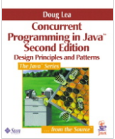
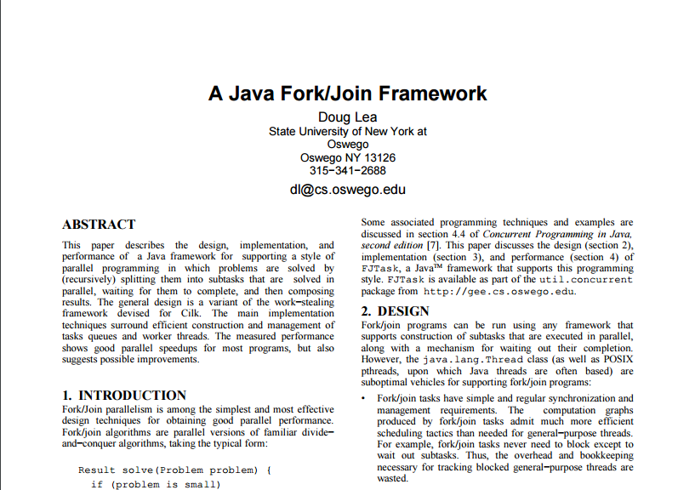

History
extension
fork-join
parallel
Files.lines()
JDK 6
JDK 7
JDK 8
JDK 9
2000
2006
2011
2014
...
Notes:
2000 - Doug Lea
2006 - Available as extension. See link.
2011 - Only ForkJoin pool is released
2014 - Parallel streams using fork-join operation on collections.
… - Files.lines().parallel() has a bugfix that allows faster processing.

Slide 8
Big Picture

Slide 9
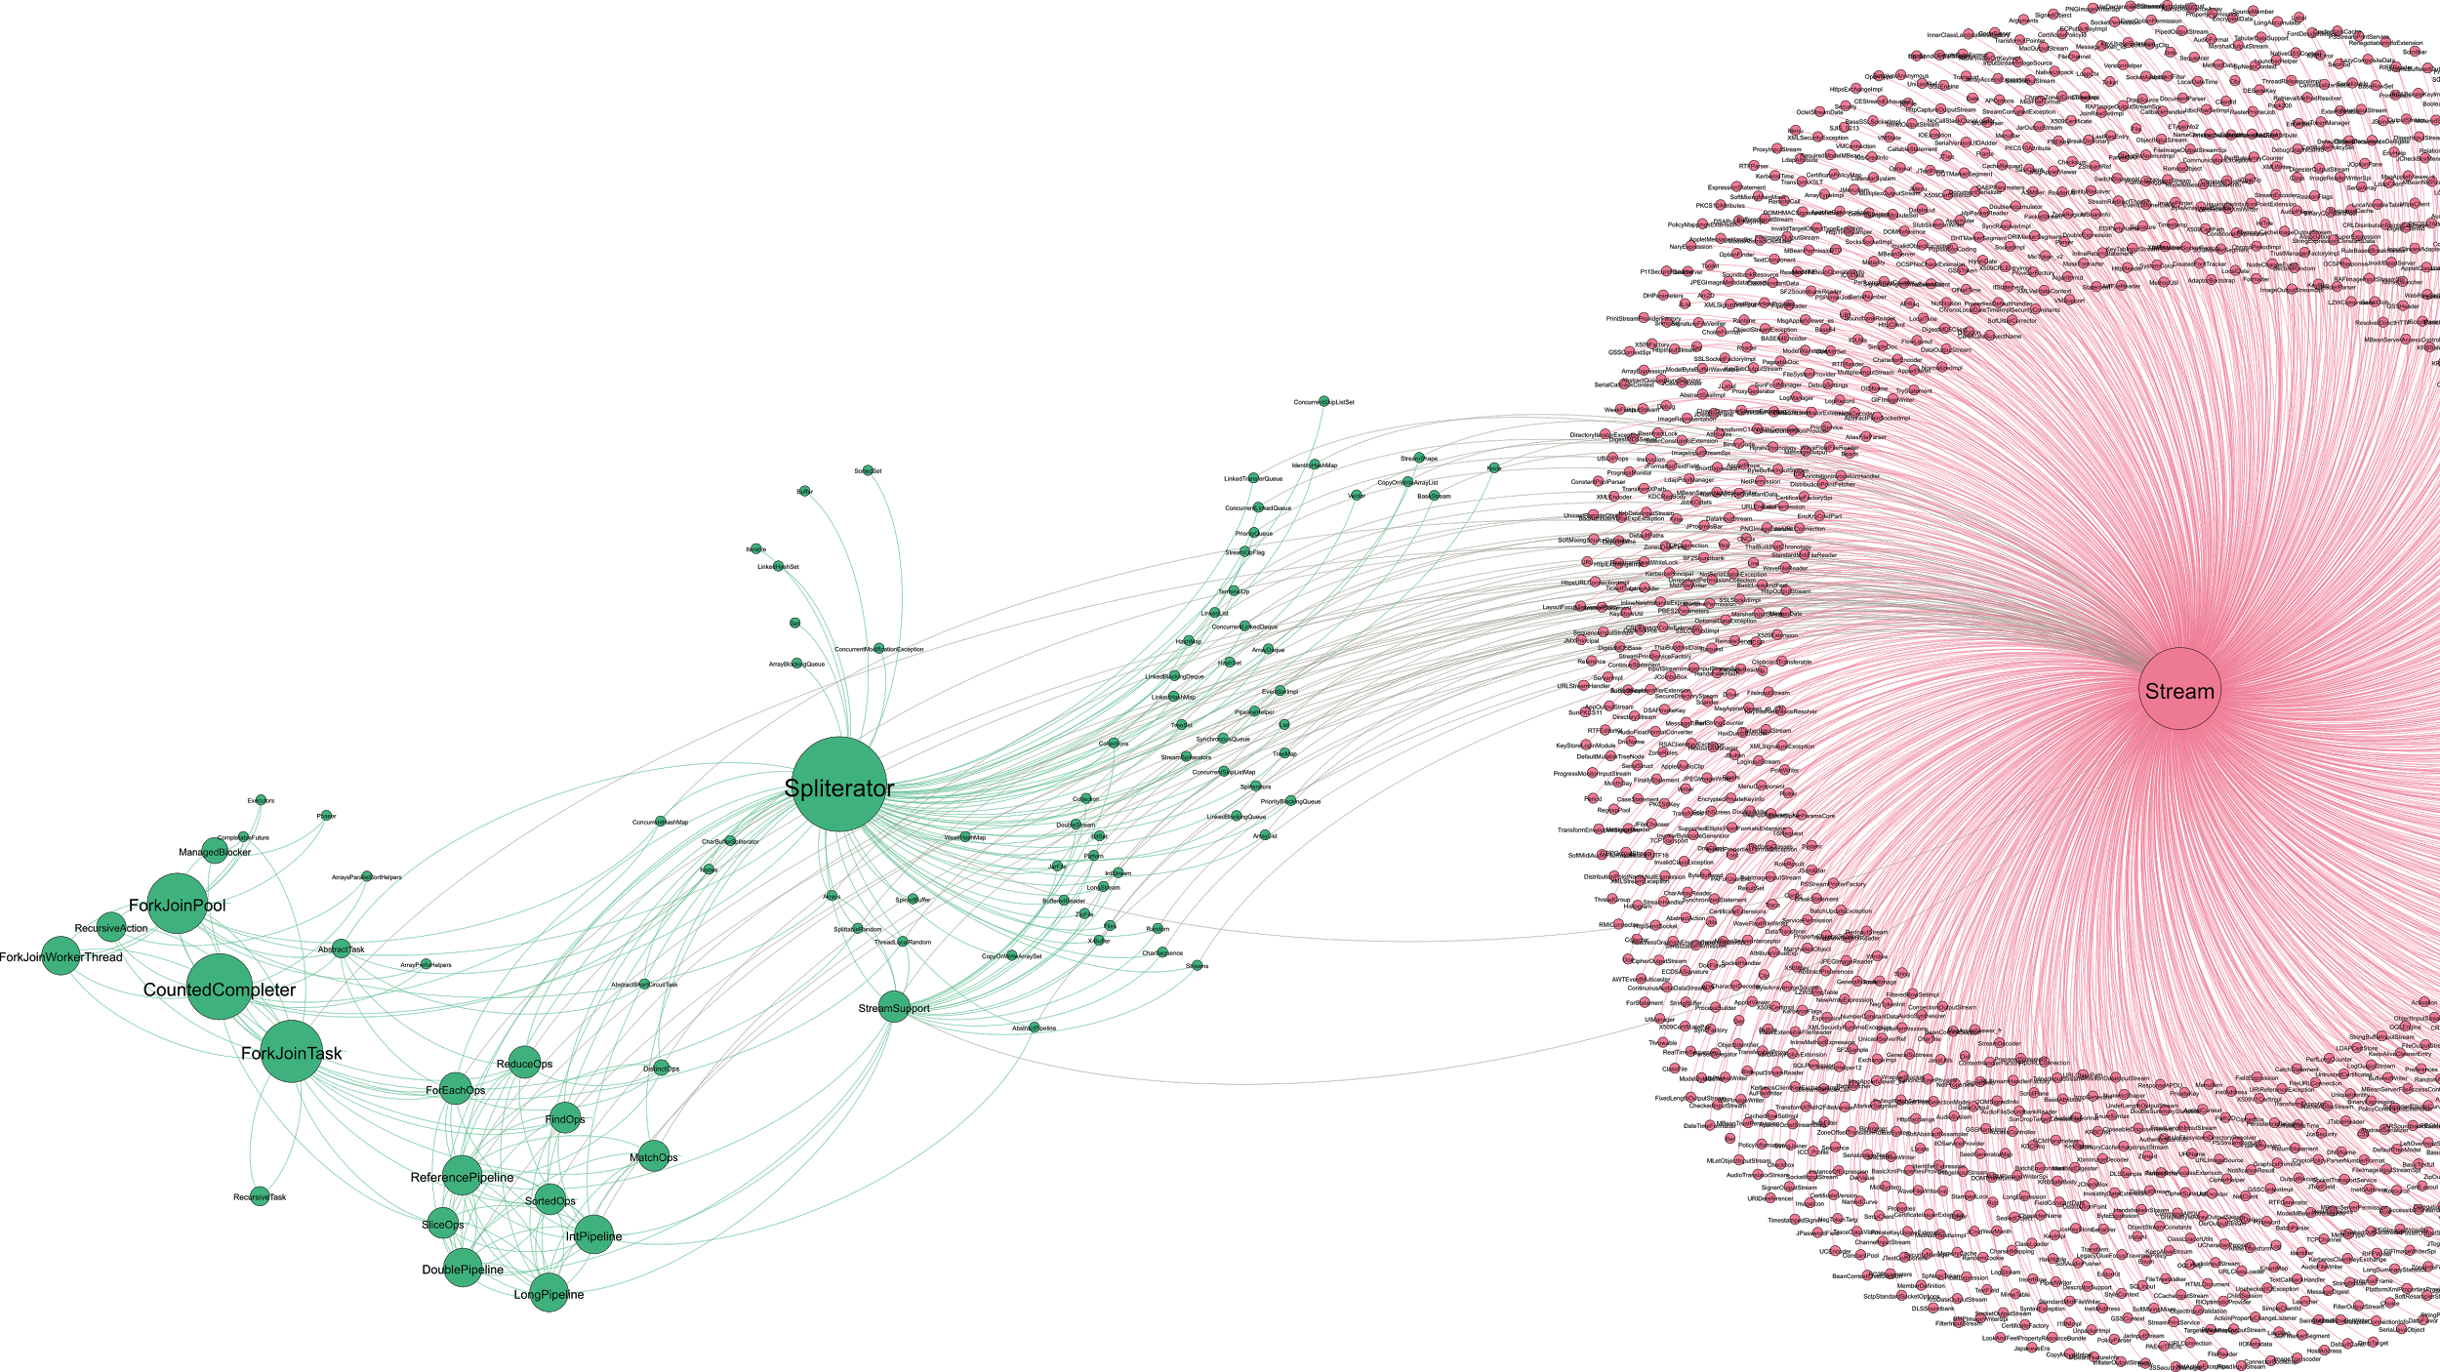
Big Picture
Notes:
Notice how hard is to add stream functionality. Lots of small classes

Slide 10
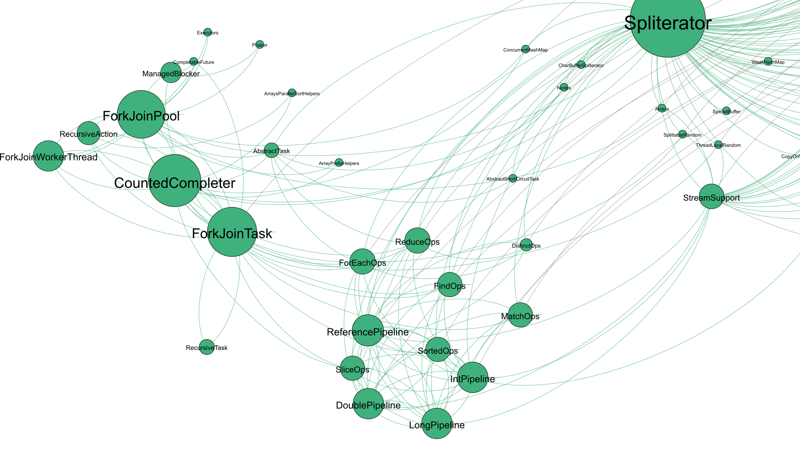

Slide 11
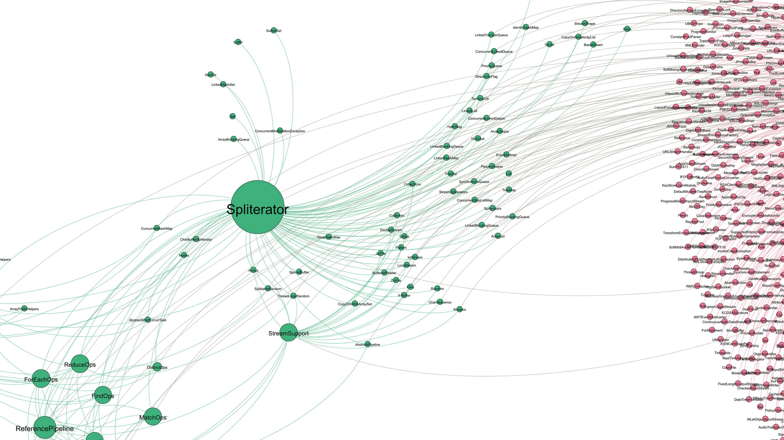

Slide 13
ForkJoinPool

Slide 14
Recursive Task Decomposition
fork
fork
fork
fork
fork
fork
join
join
join
join
join
join
Notes:
User has to implement RecursiveTask or RecursiveAction
Same is used on all collections by parallel framework
On a matrix it’s similar, but in two dimensions.

Slide 15
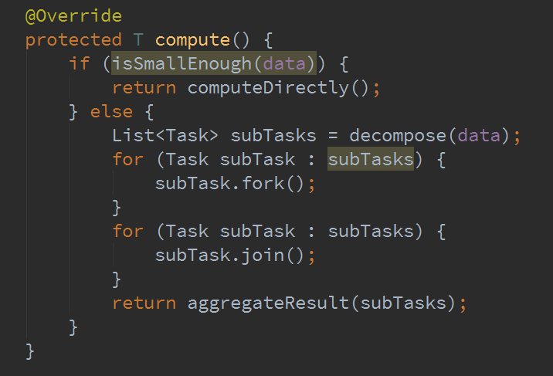

Slide 16
Anatomy
w
main
steal
w
Notes:
TODO Add java operations

Slide 17
Pros & Cons
Pros
No blocked wait on join()
Lower latency in case of multiple jobs
API for task decomposition and parallel computation
Load-balancing mechanism
Local submission queues may improve CPU caching

Slide 18
Pros & Cons
Cons
Workers are usual java.lang.Thread extensions
Computation overhead from stealing mechanism (spinlock)
Warm-up has some overhead
Hard to tune the computation. (Task decomposition granularity)
Can be slower than sequential computing
Can be memory intensive
API has some flaws
No JMX
Cryptic source code

Slide 19

The Common Pool
Notes:
When the shit hits the fan

Slide 20

The Common Pool
I’m a singleton!
boot CL
Extension CL
System CL
URL CL#1
URL CL#1
Notes:
No multitenancy
Might stall if used from multiple sources
We can’t use operations that are waiting for resources safely (see pattern later)
I/O
Shared memory access
Network wait

Slide 21
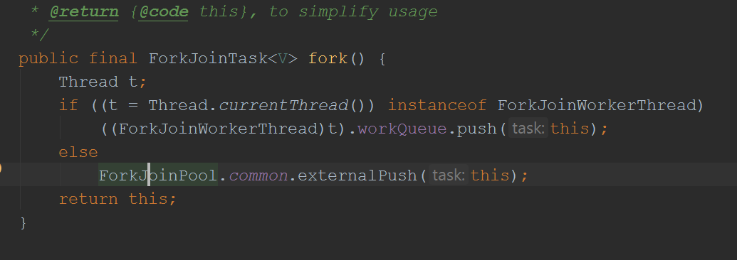
Notes:
Affects how Stream.parallel() behaves

Slide 22
Pros & Cons
Cons
No multitenancy
main thread joins the workers
Error prone
Computation may stall
We can’t use operations that are waiting for resources
I/O
Shared memory access
Network wait

Slide 23
Parallel Streams

Slide 24
CPU1
map()
filter()
CPU2
map()
filter()
Collection
stream()
parallel()
reduce()
CPU3
map()
filter()
CPU4
map()
filter()
Notes:
Collection can happen in parallel with some flags

Slide 25
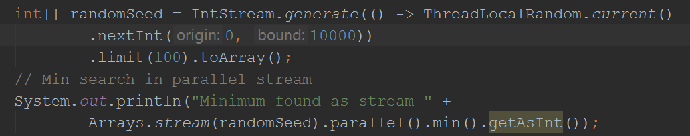
Parallel Minimum Search
Notes:
Example 1 - Parallel grep
Example 2 - Minimum search

Slide 26
Pros & Cons
CPU1
Pros
Ease of use
Functional interface
Easy to parallelize an existing method
Lots of ready-made operations in Java 8
CPU2
CPU3
CPU4
Notes:
Arrays.parallelSort()

Slide 27
Pros & Cons
CPU1
Cons
Uses common fork-join pool!
One slow operation affects others
Computation can be invalid as ordering is not guaranteed
Can be slower, than sequential stream
CPU2
CPU3
CPU4
Notes:
Priority is always on finishing existing task

Slide 28
Performance Considerations
CPU1
Collection size
Splitting efficiency
Arrays / ArrayLists
HashMaps/HashSets
LinkedLists
BlockingQueues
Operation efficiency
Dependencies
Statelessnes
CPU2
CPU3
CPU4

Slide 29
Executive Summary
Notes:
All parallel steam uses common pool
One pool per JVM
One slow operation can block all others
Waiting for resources (IO/Network/Lock) is slow
Even no JMX
How is this supposed to work in production?

Slide 30
Executive Summary
All parallel steam uses common pool
One pool per JVM
One slow operation can block all others
Waiting for resources (IO/Network/Lock) is slow
Even there’s no JMX
What can I do?

Slide 31
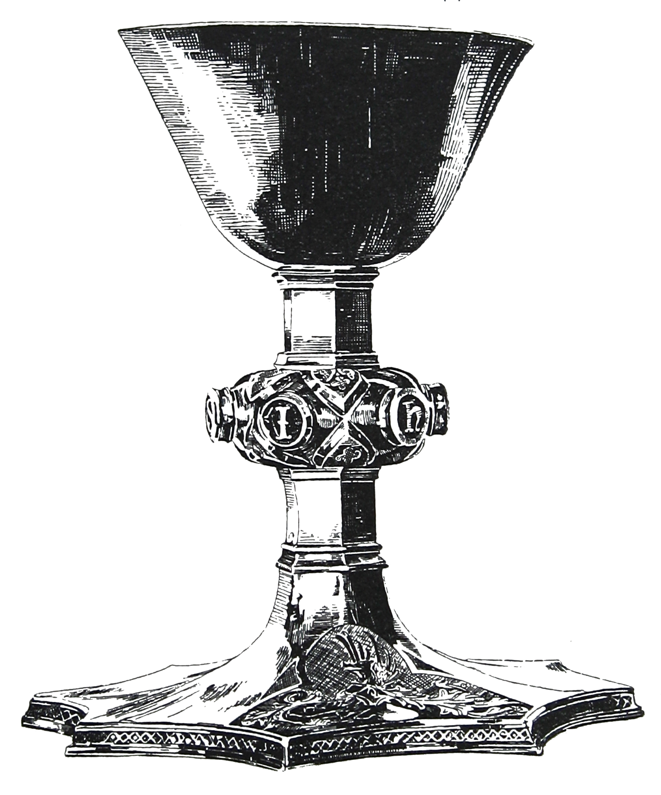
Holy Hack
How to start parallel stream using custom ForkJoinPool?

Slide 32
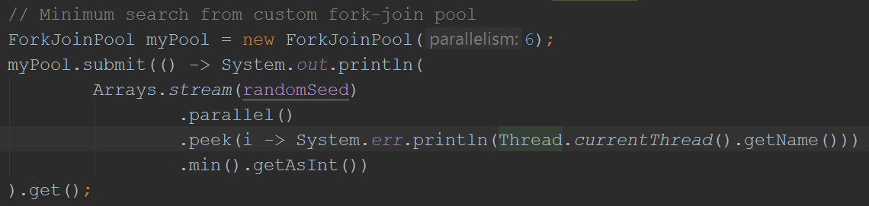

Slide 33
Notes:
We use implementation specific shortcut which is risky.

Slide 34


Holy Hack II
Using CompletableFutute

Slide 35
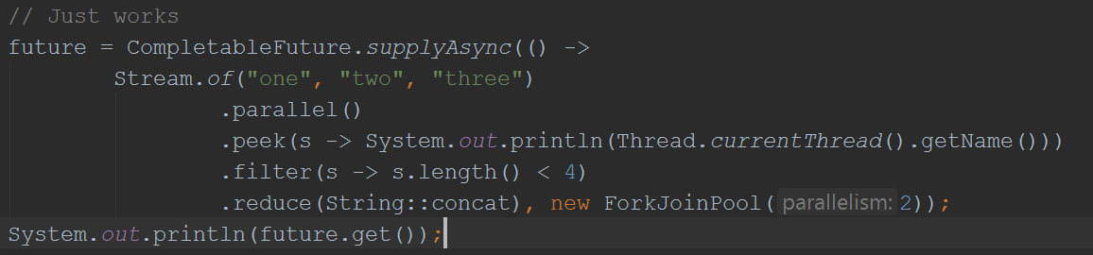
Notes:
Try out with other executors!

Slide 36
Advises
Notes:
All parallel steam uses common pool
One pool per JVM
One slow operation can block all others
Waiting for resources (IO/Network/Lock) is slow
Even no JMX
How is this supposed to work in production?

Slide 37
Advises
Avoid using the common pool
Check every library for parallel() calls
Check common-pool thread usage in test environment
Try to automate testing of parallel operations
Performance test with sequential and parallel streams
Use different collection sizes
Take number of CPUs into account
Use CompletableFuture, which has an Executor argument
Try out various executors, but be aware of what you’re doing!

Slide 38
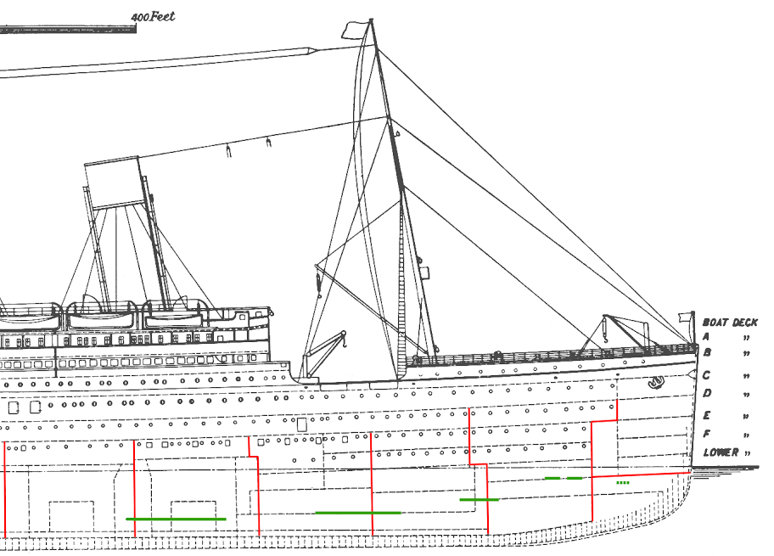
Bulkheads
Notes:
As used in Release it!

Slide 39
Using Bulkheads
pool #1
incoming requests
Service
pool #2
Gateway
Data Access
pool #3
Notes:
Each partition needs resource expense
At least use on critical paths
At least decide after understanding consequences

Slide 40
Alternatives

Slide 41
Alternatives
Reactor Core - http://projectreactor.io/
Akka - http://akka.io/
Reactive Streams - http://www.reactive-streams.org/
Speedment Java Stream ORM - https://github.com/speedment/speedment
Quasar - https://github.com/puniverse/quasar
Notes:
Can use JDK 8’s ForkJoinPool as backup framework (e.g. Akka, new Scala, Quasar)

Slide 42
Thanks!
Notes:
Who would like to use this?
Who would like to use frokbomb?

Slide 43
References
GitHub examples & presentation
https://github.com/gitaroktato/forkjoinpools-and-parallelstreams
HTTP Async calls in REST
https://jersey.java.net/documentation/latest/async.html
http://allegro.tech/2014/10/async-rest.html
Presentations discussing Java 8 ‘s parallel & asynchronous capabilities
https://www.youtube.com/watch?v=fabN6HNZ2qY
https://www.youtube.com/watch?v=h1N-qbo5VyY
https://www.youtube.com/watch?v=HdnHmbFg_hw
Talks with the authors of parallel computation in Java 8
https://www.infoq.com/interviews/doug-lea-fork-join
https://www.infoq.com/presentations/parallel-java-se-8

Slide 44
References II
Shortest path algorithm parallelization in graphs
http://www.mcs.anl.gov/~itf/dbpp/text/node35.html
http://www.cslab.ntua.gr/courses/pps/files/fall2011/paper_sfhmmy.pdf
Original Fork-Join whitepaper
http://gee.cs.oswego.edu/dl/papers/fj.pdf
ForkJoinPool explanations
http://www.h-online.com/developer/features/The-fork-join-framework-in-Java-7-1762357.html
http://howtodoinjava.com/java-7/forkjoin-framework-tutorial-forkjoinpool-example/
http://www.oracle.com/technetwork/articles/java/fork-join-422606.html
http://www.javaworld.com/article/2078440/enterprise-java/java-tip-when-to-use-forkjoinpool-vs-executorservice.html

Slide 45
References III
Parallel stream explanations
https://blog.oio.de/2016/01/22/parallel-stream-processing-in-java-8-performance-of-sequential-vs-parallel-stream-processing/
http://www.drdobbs.com/jvm/parallel-array-operations-in-java-8/240166287?pgno=2
Files.lines().parallel() issue in Java 8
http://bytefish.de/blog/jdk8_files_lines_parallel_stream/

